Slide 1
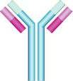
Immunology Biol 465 Minot State University Spring 2020
MWF 9-9:50 am
Lab Tuesdays 9am-noon

Slide 2
Lecture 5 January 27, 2020
Quiz 1 next Monday.
Material accumulates quickly. Make sure you are studying every lecture every time—Before the next one.
“Study” means more than a glance at the slides. I do not expect complete reading of each chapter, but headings point you to relevant explanations. Figures are essential! Redraw, interpret.

Slide 3
Where were we?
Myeloid cells
Lymphoid cells
Name some. What is their role in immunity?
Draw them—using your book’s symbols.
Lymphoid tissue/organs
General purpose
Organization of lymph node
Central vs peripheral

Slide 4
Let’s return to the lymph node and think of its purpose
It allows contact between antigen and antigen receptors. The location of specific cell types allows interactions that spur an adaptive immune response.
Antigen can be transported in.
Cells such as dendritic cells can physically contact T-cells
T-cells can physically contact B-cells

Slide 5
What occurs when antigen matches antigen receptor?
First mass reproduction of that cell---all daughter cells, will, of course, produce the same antigen receptor—these receptors are proteins encoded by the DNA of the cell.
Called Clonal expansion

Slide 6
Example---is development of masses of B-cells in a lymph node.
Called germinal centers.
If the expansion is large, we can notice a “swollen gland”

Slide 7
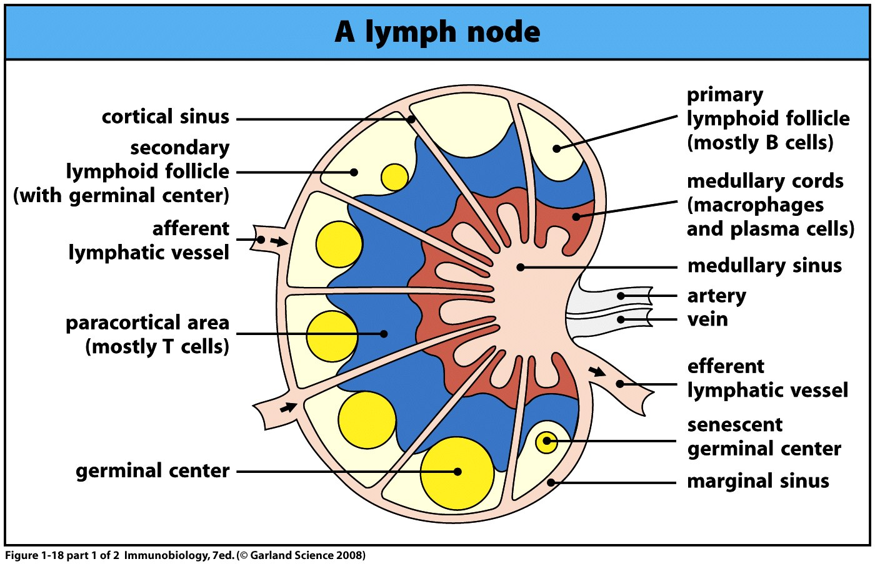

Slide 8
Chapter 1 includes more detail than we need for now, but let’s briefly discuss the outcome of activation of B and T lymphocytes.
What are the effector mechanisms?...

Slide 9
B-cells
Recall…activation results in clonal expansion---production of lots and lots of B-cells capable of binding the same antigen.
B-cells are good for dealing with extracellular pathogens (like most bacteria) and the potentially harmful molecules they produce.

Slide 10
B-cell produce antibodies
What do antibodies do? 3 main effector mechanisms.
1. Neutralization—binding and blocking the action of toxins, virus particles etc.
2. Opsonization—binding/coating of pathogen to mark it for destruction by other cells
E. Activation of a system called the complement pathway---multi-step process to destroy bacteria.

Slide 11
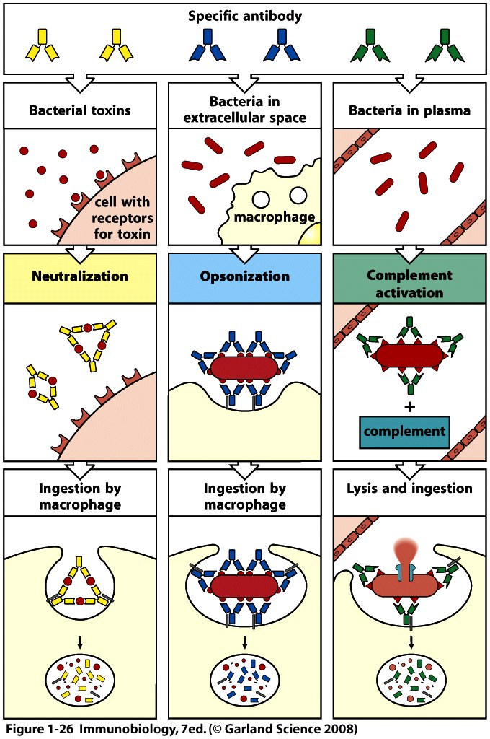

Slide 12
T-cell effector mechanisms
Cell-mediated immunity—requires direct interaction between the T-cell and another host cell.

Slide 13
T-cells differentiate into 2 types of effector cells
Cytotoxic T lymphocytes (CTLs or T_{c})—act directly to kill virus-infected cells. Release of toxins after binding to virus-infected cell.
Express a specific cell surface molecule-- a co-receptor called CD8.
CTLs=CD8+ T-cells.

Slide 14
Helper T-cells=T-helper cells= T_{H} cells
Do not kill pathogen or pathogen-infected cells directly, but activate other cells to their full effector function.
B-cells
Macrophages
CTLs

Slide 15
T_{H} cells
Express a different co-receptor than CTLs
CD4
T_{H} cells=CD4+ T-cells

Slide 16
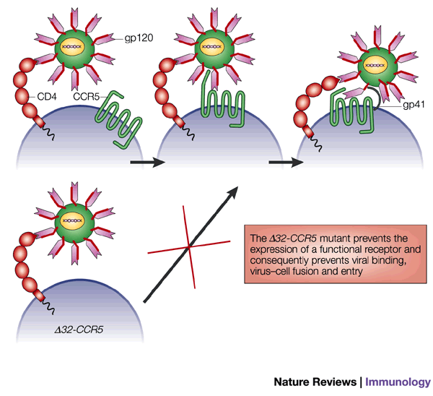
Interesting…
CD4 T-cells are the specific target of the HIV virus. The virus uses the CD4 surface molecule as its receptor to access the cell. The infection kills many T_{H} cells.

Slide 17
The importance of these cells is recognized in the inability of HIV-infected individuals to mount effective immune responses, despite having normal numbers of B-cells and CTLs.
AIDS is the result of a lack of CD4+ T-cells

Slide 18
2 types of T_{H} cells
1. T_{H} 1 cells—specialized for controlling intracellular bacteria—Tuberculosis is caused by a type of bacterium which gets into macrophages. (Most bacteria are extracellular). T_{H} 1 cells activate the macrophage to kill the bacteria

Slide 19
2. TH₂ cells seem to be most important in activating B-cells. So indirectly important in the humoral response.

Slide 20
MHC
Chapter 1 introduces another very important type of molecule in immunology.
Major Histocompatability complex proteins. (Also called Human leukocyte antigen—HLA) in humans.
These are proteins expressed by APCs which actually hold onto the antigen for the T-cell to see.

Slide 21
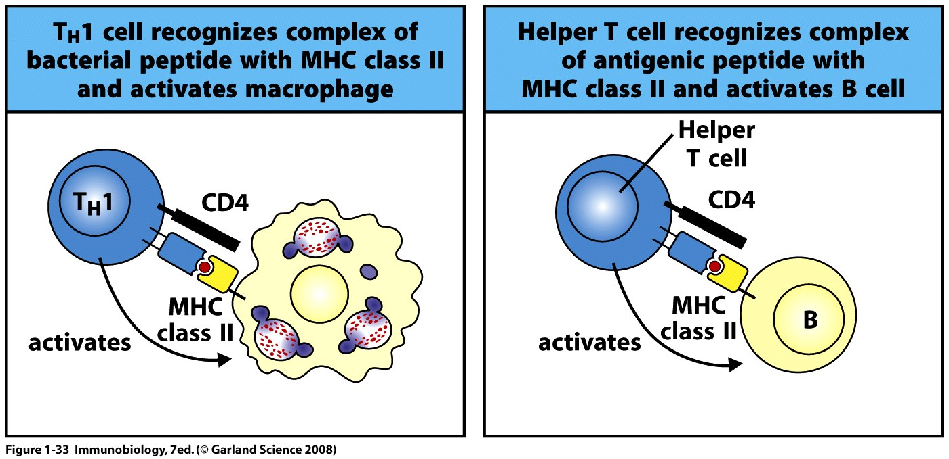

Slide 22
MHC was discovered somewhat by accident when tissue transplants were first attempted.
MHC is highly variable among individuals and is important in establishing self tolerance.
Someone else’s MHC looks like a pathogen to a host’s immune system.
When referring to a “tissue match” we are really referring to MHC proteins.

Slide 23
Innate immunity—chapter 2

Slide 24
Chapter 2—innate immunity
Chapter 2 takes a detailed look at the body’s first-line defense system against pathogens.
Although not technically an immune “response” the body’s first defense is its anatomic, tissue and cellular barriers.

Slide 25
Epithelial barriers
Cells known as epithelia form the skin and lining of our internal tubular structures such as the air passages, gut, and urogenital tracts.
Epithelial cells are arranged with tight junctions and with modifications that help keep pathogens out! They provide mechanical barriers.

Slide 26
Epithelial cells also produce some of the chemicals that inhibit microbial growth.
Epithelial cells also provide an environment that supports beneficial microbial growth—the so-called normal microflora/microbiota.

Slide 27
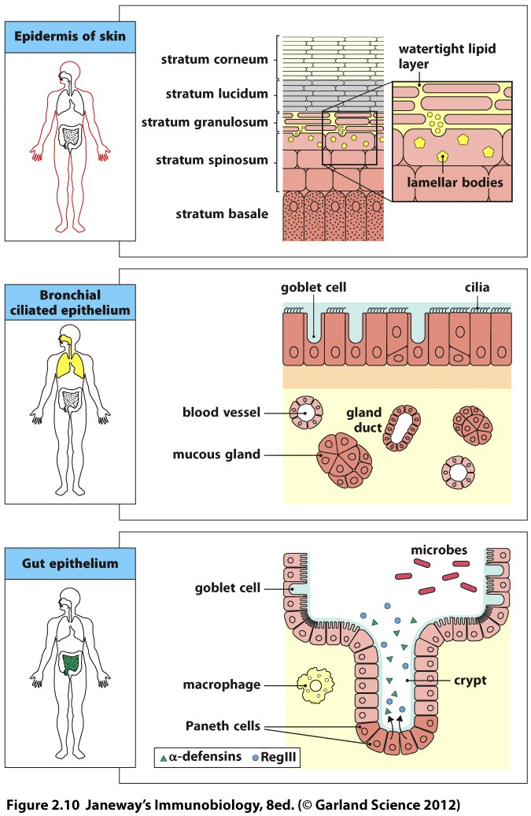

Slide 28
Skin
Skin---epithelial cells differentiate into the layers making up the epidermis. While differentiating the epithelial cells secret lipid and antimicrobial proteins such as β-defensins and cathelicidins
Specialized cells of the skin produce enzymes like lysozyme, which digests bacterial cell walls.

Slide 29
Respiratory tract
Mouth, trachea, lungs
Lined with ciliated epithelia which also secrete mucus (called mucosal epithelia)
Continuous movement of cilia moves potential pathogens along and keeps them out.

Slide 30
Gastrointestinal tract/gut
Lined with specialized mucosal epithelium which secrete antimicrobial proteins. (α-defensins and RegIII)
Also have a mixed population of normally non-pathogenic bacteria (normal flora, microbiota, commensal bacteria)
Low pH limits the type of microorganisms that can survive here

Slide 31
Role of normal microflora
Compete with pathogenic bacteria for nutrients and ability to attach to to cells.
Stimulate epithelial cells to produce antimicrobial proteins
Produce acids (lactic acid) that keeps pathogens from thriving

Slide 32
Opportunistic pathogens
The importance of normal microflora is evident when the environment of the host changes and they are diminished or lost.
Example…antibiotic treatment often wipes out normal bacteria in the vagina. Yeast can take over in the absence of the bacteria and due to the change in pH.

Slide 33
Figure 2.5
Summarizes some of the ways in which epithelial cells keep pathogens from gaining access to the body.

Slide 34
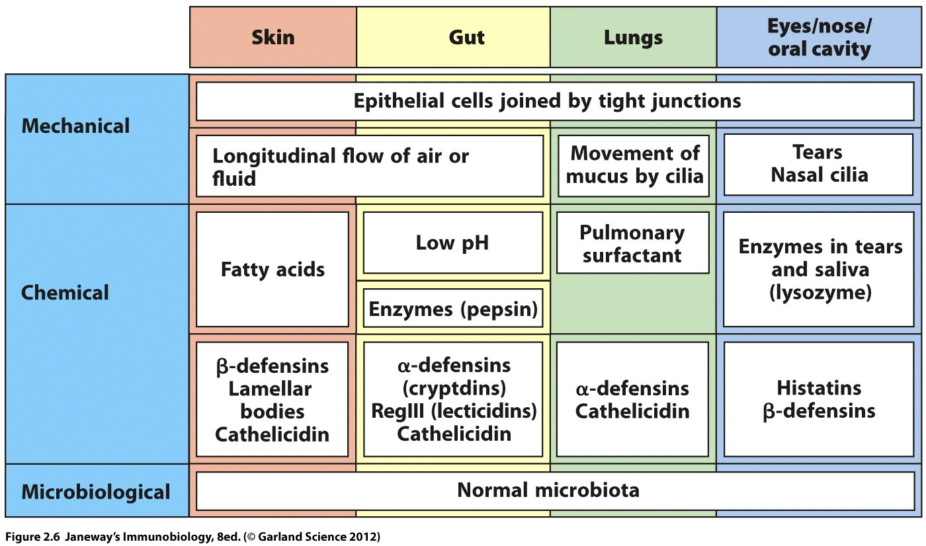

Slide 35
Despite the excellent set of mechanical, chemical, and microbial barriers, some pathogens gain access to every host as some time.

Slide 36
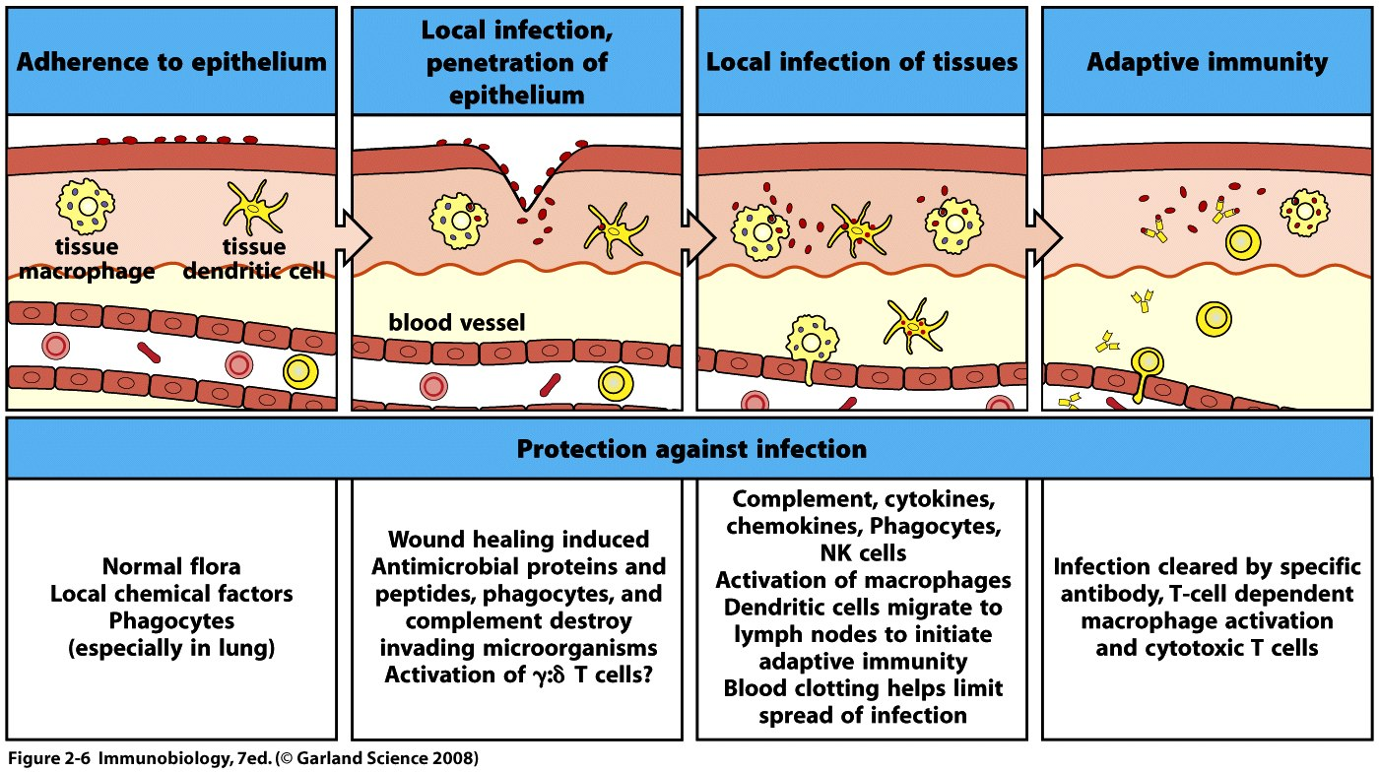

Slide 37
Routes of infection
Think of all the ways in which you have become infected by a pathogen. How does one get strep throat? Chicken pox? Cold? “Food poisoning”? STD?
Different types of organisms gain access via different routes.

Slide 38
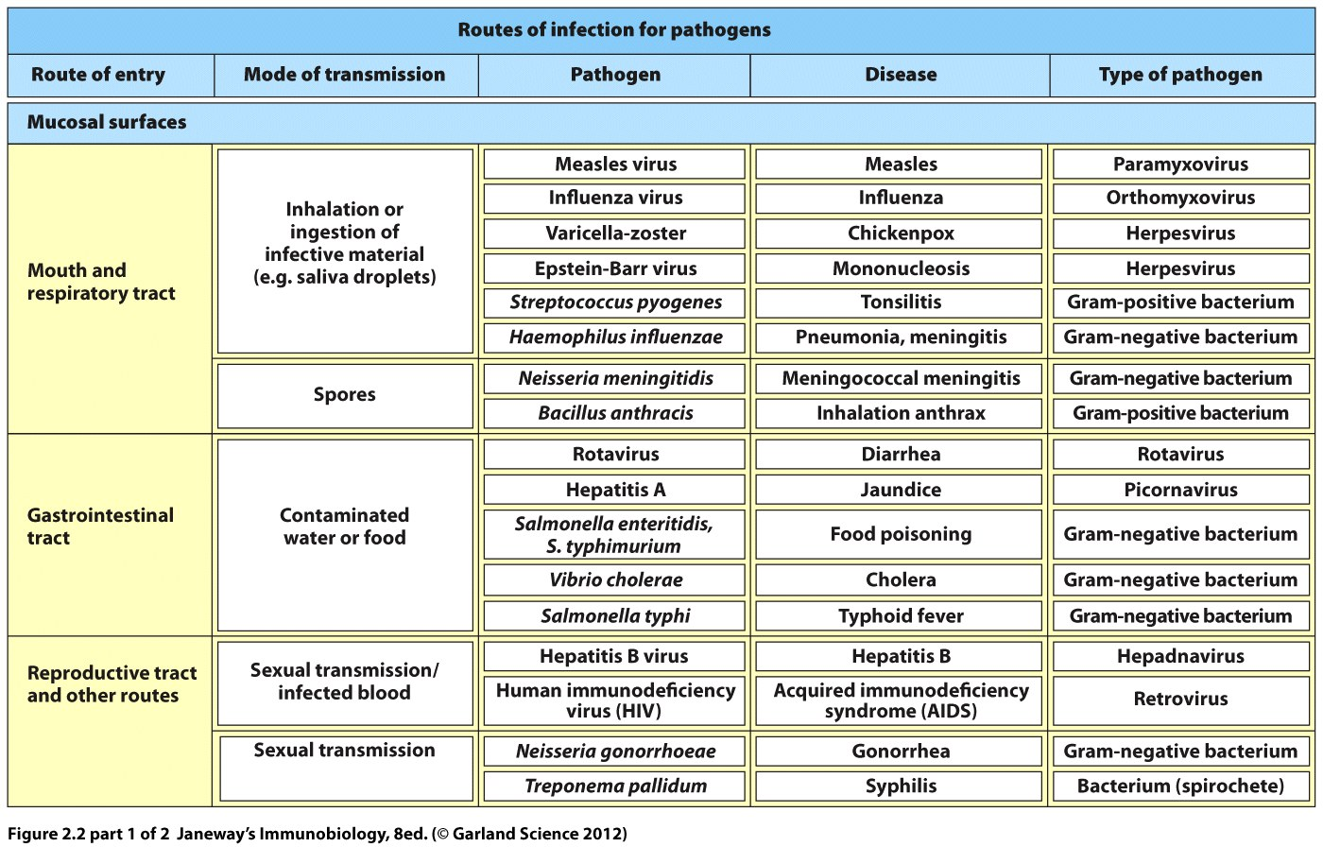
Figure 2.5
Circle panels one and two

Slide 39
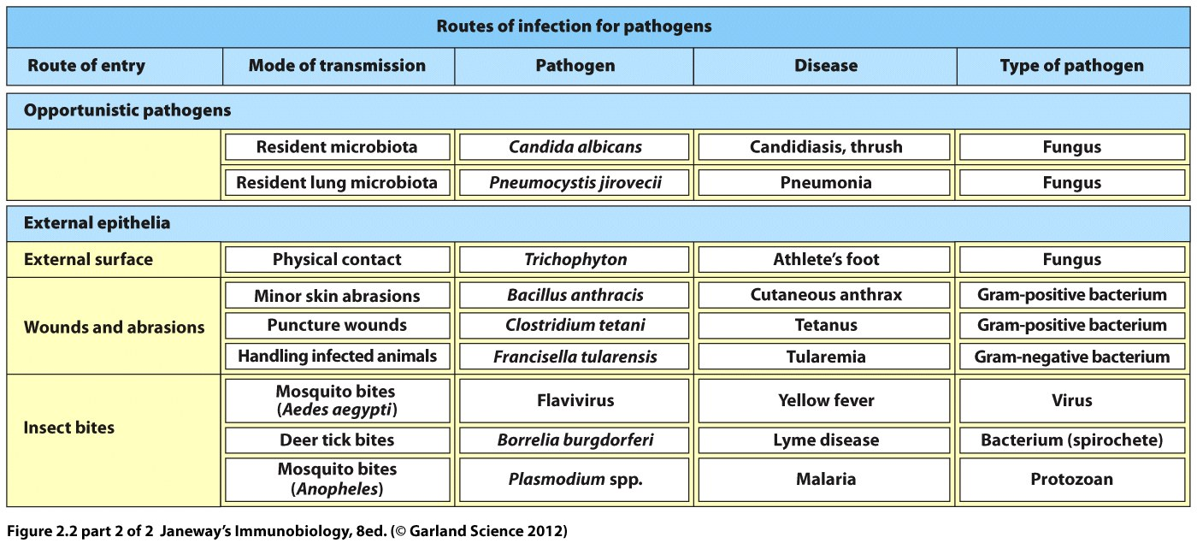
Figure 2.2

Slide 40
Once inside the host different organisms must occupy different regions to replicate and thrive.
Most organisms will be outside the cell initially. Some will need to occupy the cell, either the cytoplasm or a vesicle of the cell.

Slide 41
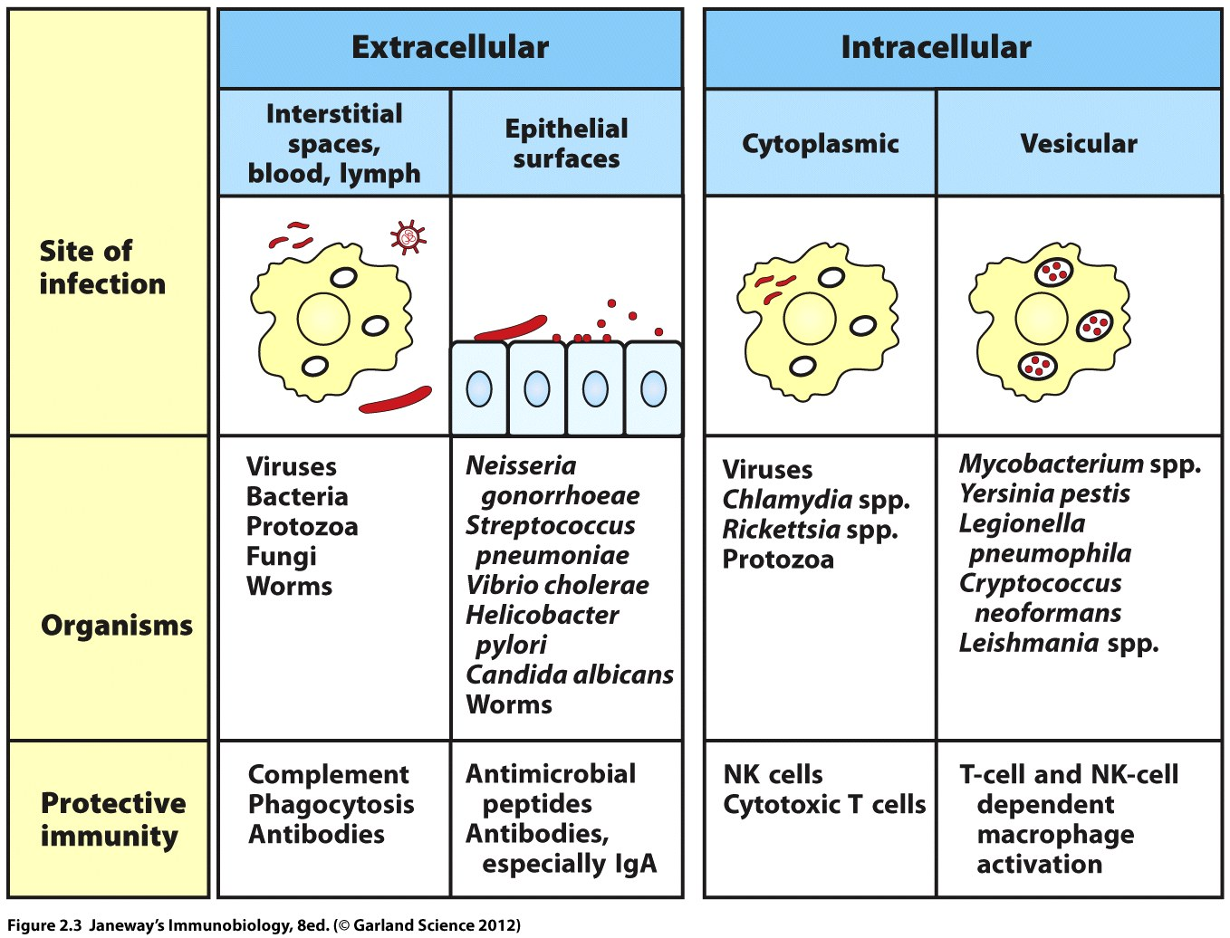
Figure 2.3

